Slide 1
Bankruptcy & Financial Distress

Slide 2
Tradeoff view of cap structure
Bankruptcy/
financial distress costs
Unlevered value
Tax shields
Debt*
Debt
$$Value=Unlevered value+TaxShields(Debt)−BRCosts(Debt)$$
$$TaxShields^{′}({Debt}^{∗})=BRCosts^{′}({Debt}^{∗})$$
$$(Marginal Benefit of Debt)=(Marginal Cost of Debt)$$

Slide 3
Financial distress costs
Financial distress costs: Costs due to financial distress, not economic misfortune of the business
Direct costs of bankruptcy: Costs borne as a result of company entering bankruptcy
Legal expenses
Court fees
Management distraction
Indirect costs of bankruptcy: Costs borne as a result of the possibility of bankruptcy (much more on these later in the slides)

Slide 4
Financial vs economic distress
Total Firm Value
Economic Distress
Economic Distress
Financial Distress
All-Equity Firm
Firm with Debt

Slide 5
Financial vs economic distress
Toyota stock price in 2008
12/31/07 Balance Sheet
Total Assets: ¥32.6T
Total Liabilities: ¥20.1T (62% of assets)

Slide 6
Financial vs economic distress
General Motors stock price in 2008
12/31/07 Balance Sheet
Total Assets: $148.8B
Total Liabilities: $184.4B (124% of assets)

Slide 7
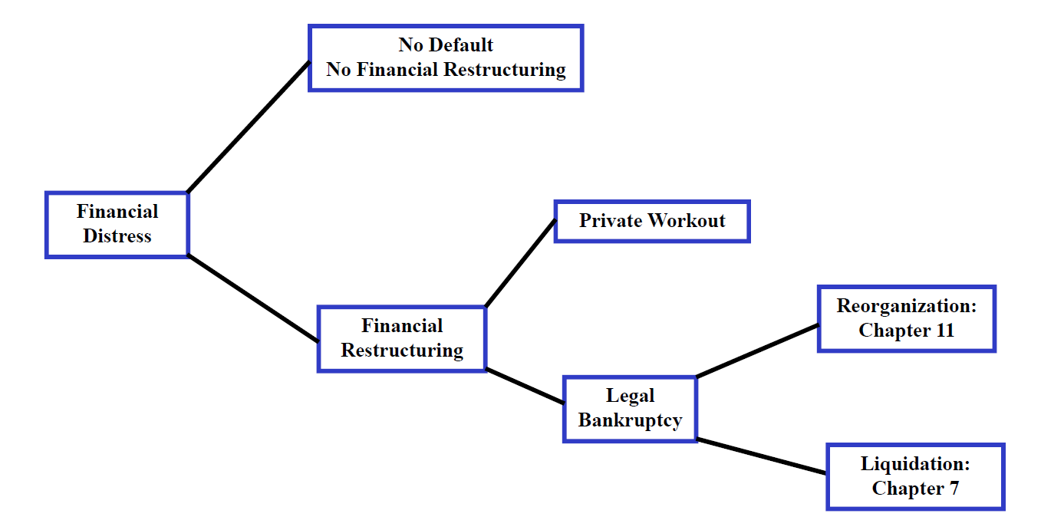
Options in financial distress

Slide 8
Chapter 7 bankruptcy (liquidation)
Sketch of Process:
Trustee appointed by bankruptcy court sells assets
Proceeds from asset sales distributed to creditors
Shareholders receive whatever is left (usually nothing)
Absolute Priority Rule (APR)
Administrative expenses
New claims approved after filing
Wages & salaries
Employee benefits claims
Consumer claims
Tax claims
Senior debtholders
Junior debtholders
Preferred stockholders
Common stockholders
Exception: Secured creditors have right to collateral

Slide 9
Ch 11 bankruptcy (reorganization)
Rough sketch of events:
Petition filed in federal court
Federal judge approves/denies the petition
Equityholders continue to run business
Company given 120 days to submit a reorganization plan
Creditors divided into priority classes to vote on plan. Class approves plan if >2/3 of $ amount in class or >1/2 of creditors in class vote for plan
If plan is approved by all creditor classes, court approves plan
Payments (cash & securities) are made, new securities are issued
Company exits bankruptcy
Important elements of Ch. 11:
Automatic stay (debt payments stop; creditors cannot seize collateral)
Debtor-in-possession financing (court subordinates existing debt to new debt)

Slide 10
Bankruptcy statistics
Days spent in each Chapter 11 phase
 | Filing to plan submission | Plan submission to confirmation | Confirmation to closure
Mean | 207 | 225 | 239
Median | 152 | 154 | 171
% < 120 days | 22%
Percentage recovery rates
Secured recovery |  | Unsecured recovery
Ch. 7 | Ch. 11 | Ch. 7 | Ch. 11
32.4% | 90.2% | 1.1% | 51.6%
APR violated in 12.2% of Ch. 7 cases

Slide 11
Financial distress costs
Bankruptcy & financial distress costs limit amount of debt a company should take on
Estimates of direct costs of bankruptcy (legal expenses, court costs, management distraction, etc.):
About 3% of company value, on average
Can be bigger % for smaller companies
Direct costs of bankruptcy too small to balance out tax benefits of debt
3% of already diminished firm value
Present value small at time of financing: need to multiply bankruptcy cost by probability of bankruptcy and then discount to compute
Indirect costs (will get to shortly) are the more important costs of financial distress in most cases

Slide 12
Who bears bankruptcy costs?
Suppose company goes bankrupt, bears $100,000 of legal costs in bankruptcy; who bears these (and any other) bankruptcy costs?
Equityholders usually wiped out in bankruptcy
Creditors bear costs of bankruptcy at the time when they occur
So why should equityholders worry about potential bankruptcy costs when choosing company’s debt level?
Creditors presumably anticipate costs of bankruptcy and price-protect themselves w/ higher interest rate
So, equityhoders bear the costs of potential bankruptcies up front

Slide 13
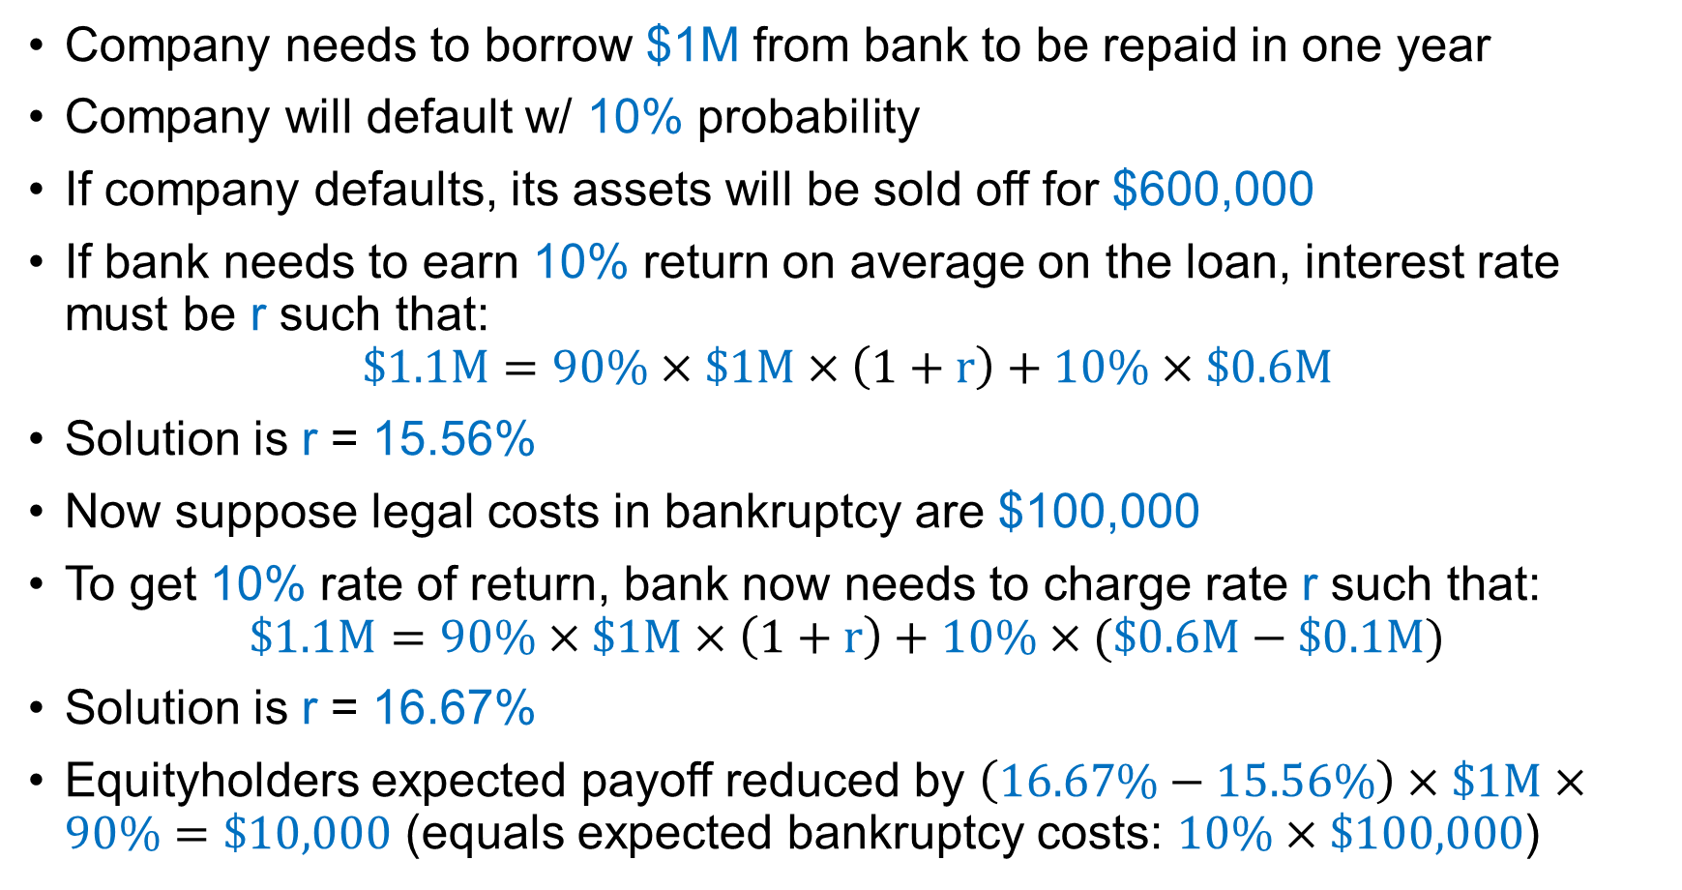
Who bears bankruptcy costs?
Company needs to borrow $1M from bank to be repaid in one year
Company will default w/ 10% probability
If company defaults, its assets will be sold off for $600,000
If bank needs to earn 10% return on average on the loan, interest rate must be r such that:
$$\$1.1M=90\%×\$1M×\left(1+r\right)+10\%×\$0.6M$$
Solution is r = 15.56%
Now suppose legal costs in bankruptcy are $100,000
To get 10% rate of return, bank now needs to charge rate r such that:
$$\$1.1M=90\%×\$1M×\left(1+r\right)+10\%×(\$0.6M−\$0.1M)$$
Solution is r = 16.67%
Equityholders expected payoff reduced by $\left(16.67\%−15.56\%\right)×\$1M×90\%=\$10,000$ (equals expected bankruptcy costs: $10\%×\$100,000$)

Slide 14
Indirect financial distress costs
Companies w/ debt outstanding may invest and operate less efficiently than those w/o debt outstanding → “indirect financial distress costs”
Shareholders do not account for well-being of creditors
Potential new suppliers of capital do not account for well-being of existing investors
Reduce payoffs even absent the occurrence of bankruptcy
Two main distortions leading to indirect costs:
Debt overhang
Risk-shifting (aka asset-substitution)

Slide 15
Debt overhang – Chrysler, 2008
PE firm Cerberus Capital Management bought Chrysler in 2007.
In November 2008, Chrysler CEO Robert Nardelli argued that financial crisis was creating temporary distress, asked Congress for $7B to keep Chrysler in business.
Wisconsin Rep. Steve Kagen: “If Cerberus truly believes Chrysler is a good investment, then Cerberus should put up some of their own money. The question is why are you coming to taxpayers if it's not such a good deal?”
Nardelli’s response: “Cerberus' fiduciary obligations to its other investors and investments prohibits it from injecting capital”
Why does Chrysler need government bailout if keeping Chrysler in business is a positive NPV investment?

Slide 16
Debt overhang example
Pharmaceutical startup invests $20M in year 0 to develop a promising new drug and conduct trials
Two possible outcomes of trials (everybody observes the outcome):
Drug highly-effective (80% probability): Potential CF of $50M in year 2
Drug moderately-effective (20% probability): Potential CF of $27.5M in year 2
To realize potential year 2 CFs, company needs to spend $10M in year 1 (after outcome of trials) to market it (otherwise, CF = $0)
Company has no cash, has to raise capital to market drug in year 1
No discounting (for simplicity only)
Marketing drug always positive NPV ($27.5M > $10M)
Will company be able to raise capital to market the drug?
Depends on how initial development was financed

Slide 17
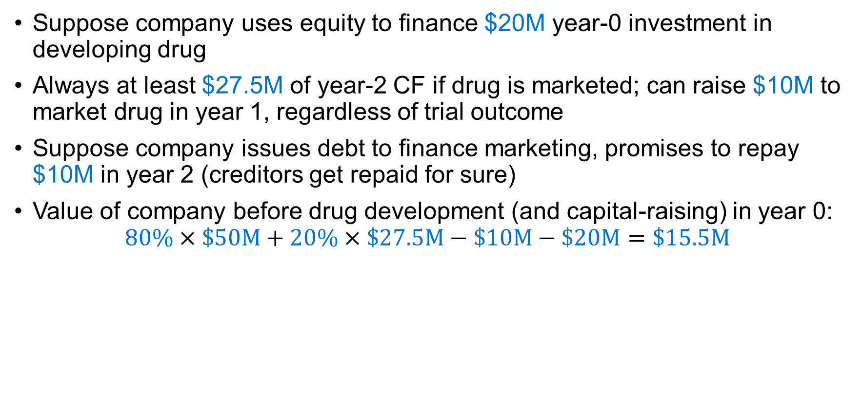
Debt overhang example
Suppose company uses equity to finance $20M year-0 investment in developing drug
Always at least $27.5M of year-2 CF if drug is marketed; can raise $10M to market drug in year 1, regardless of trial outcome
Suppose company issues debt to finance marketing, promises to repay $10M in year 2 (creditors get repaid for sure)
Value of company before drug development (and capital-raising) in year 0:
$$80\%×\$50M+20\%×\$27.5M−\$10M−\$20M=\$15.5M$$

Slide 18
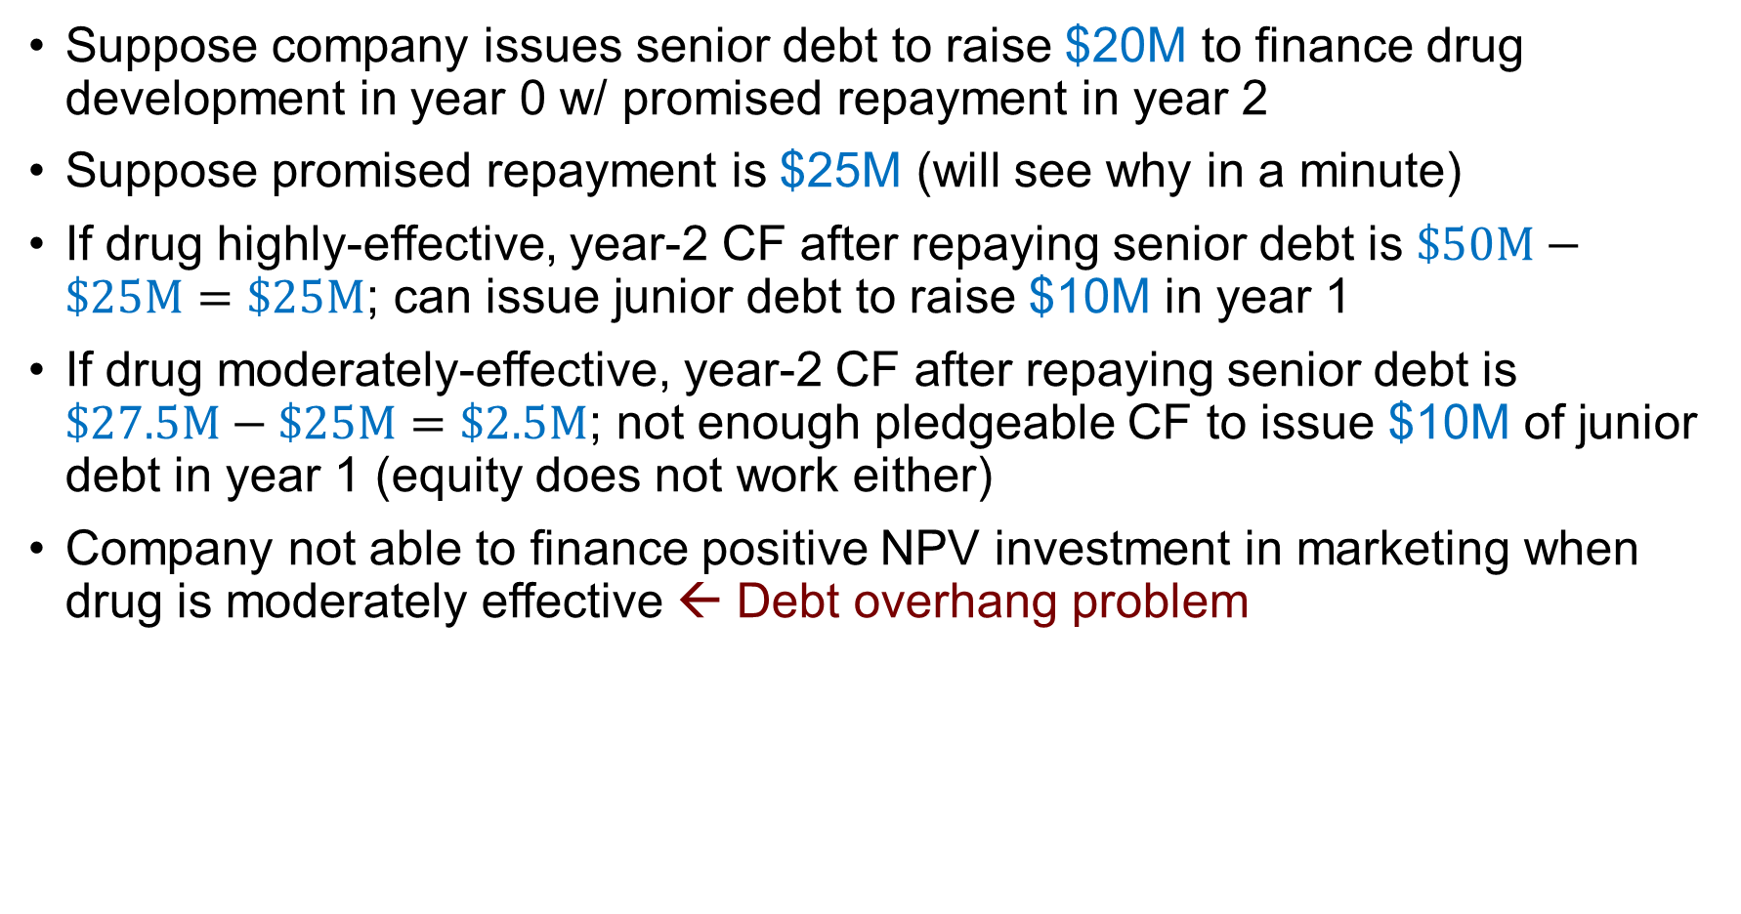
Debt overhang example
Suppose company issues senior debt to raise $20M to finance drug development in year 0 w/ promised repayment in year 2
Suppose promised repayment is $25M (will see why in a minute)
If drug highly-effective, year-2 CF after repaying senior debt is $\$50M−\$25M=\$25M$; can issue junior debt to raise $10M in year 1
If drug moderately-effective, year-2 CF after repaying senior debt is $\$27.5M−\$25M=\$2.5M$; not enough pledgeable CF to issue $10M of junior debt in year 1 (equity does not work either)
Company not able to finance positive NPV investment in marketing when drug is moderately effective ← Debt overhang problem

Slide 19
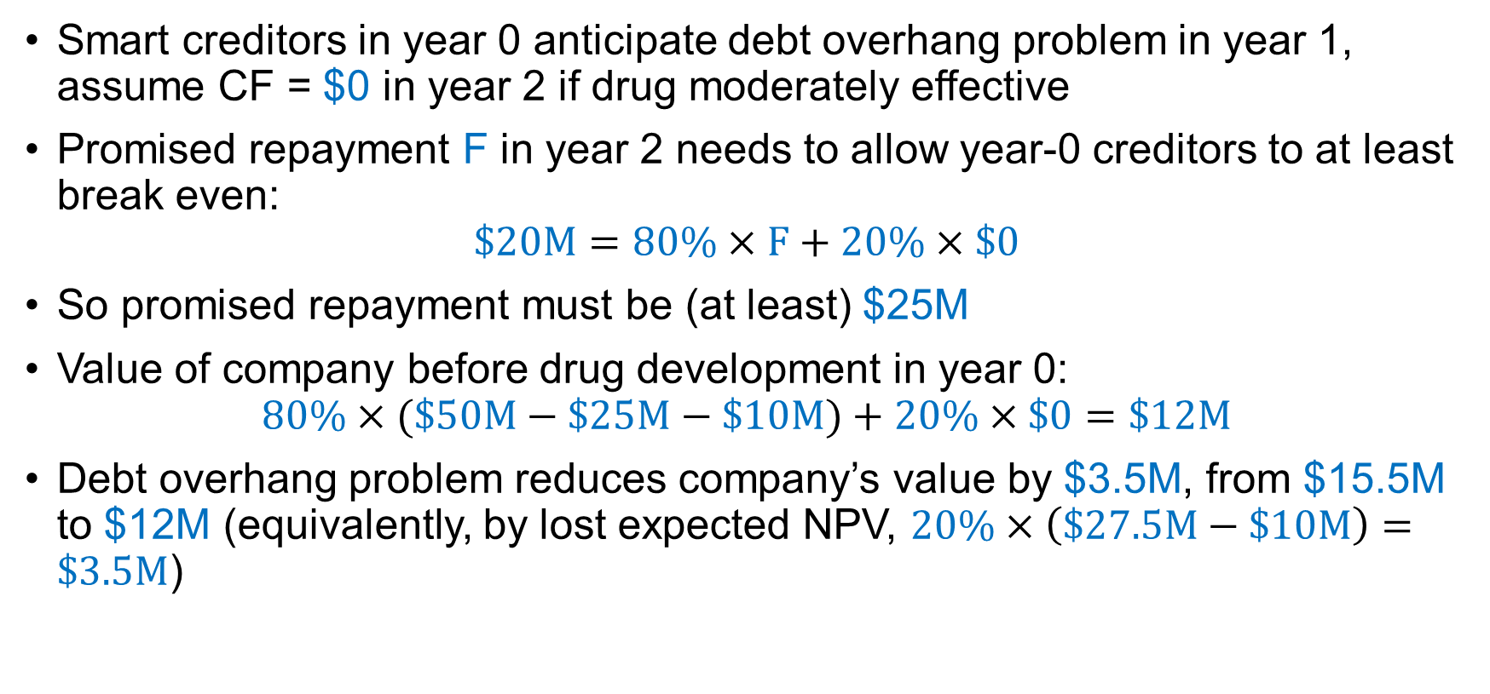
Debt overhang example
Smart creditors in year 0 anticipate debt overhang problem in year 1, assume CF = $0 in year 2 if drug moderately effective
Promised repayment F in year 2 needs to allow year-0 creditors to at least break even:
$$\$20M=80\%×F+20\%×\$0$$
So promised repayment must be (at least) $25M
Value of company before drug development in year 0:
$$80\%×(\$50M−\$25M−\$10M)+20\%×\$0=\$12M$$
Debt overhang problem reduces company’s value by $3.5M, from $15.5M to $12M (equivalently, by lost expected NPV, $20\%×\left(\$27.5M−\$10M\right)=\$3.5M$)

Slide 20
Debt overhang
Debt overhang: Tendency to pass up positive NPV investments when existing creditors capture most of the benefits from investment
In the example, marketing drug increases existing creditor’s payoff by $25M when drug is moderately-effective
Year-1 investors do not want to invest just to shore up value of debt claims
Solutions:
Finance initial $20M investment w/ equity or junior debt
Ask existing creditors for $10M to market drug in year 1 (works if one creditor supplied initial $20M; free-rider problem if multiple creditors)
Raise full $30M by issuing debt up front instead of raising capital in yr 1
Equityholders of levered company may choose not to raise capital to make positive NPV investments, even if they can (see next example)

Slide 21
Debt overhang example 2
Company has assets in place that pay off $50M or $150M in one year, each w/ 50% probability
Company has senior debt of $120M due in one year
Company has following investment opportunity:
Invest $50M today
Receive $80M in one year
Company has no cash, needs to raise additional capital to finance any investment
No discounting, no taxes (for simplicity)
NPV of investment opportunity = $80M – $50M = $30M > $0
Can company make this positive NPV investment? Should it?

Slide 22
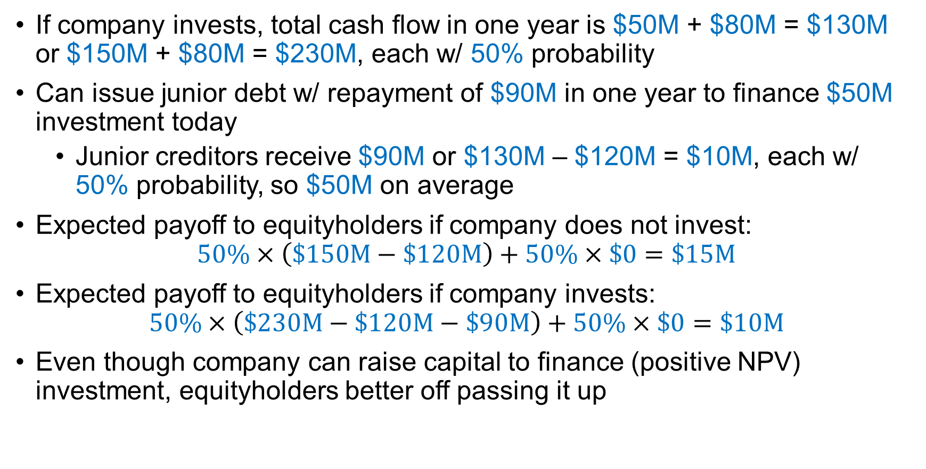
Debt overhang example 2
If company invests, total cash flow in one year is $50M + $80M = $130M or $150M + $80M = $230M, each w/ 50% probability
Can issue junior debt w/ repayment of $90M in one year to finance $50M investment today
Junior creditors receive $90M or $130M – $120M = $10M, each w/ 50% probability, so $50M on average
Expected payoff to equityholders if company does not invest:
$$50\%×\left(\$150M−\$120M\right)+50\%×\$0=\$15M$$
Expected payoff to equityholders if company invests:
$$50\%×\left(\$230M−\$120M−\$90M\right)+50\%×\$0=\$10M$$
Even though company can raise capital to finance (positive NPV) investment, equityholders better off passing it up

Slide 23
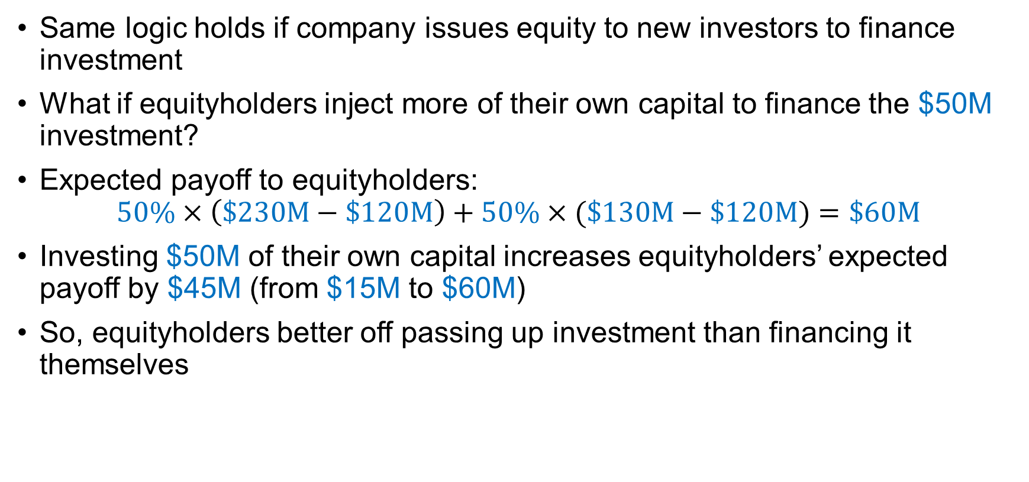
Debt overhang example 2
Same logic holds if company issues equity to new investors to finance investment
What if equityholders inject more of their own capital to finance the $50M investment?
Expected payoff to equityholders:
$$50\%×\left(\$230M−\$120M\right)+50\%×(\$130M−\$120M)=\$60M$$
Investing $50M of their own capital increases equityholders’ expected payoff by $45M (from $15M to $60M)
So, equityholders better off passing up investment than financing it themselves

Slide 24
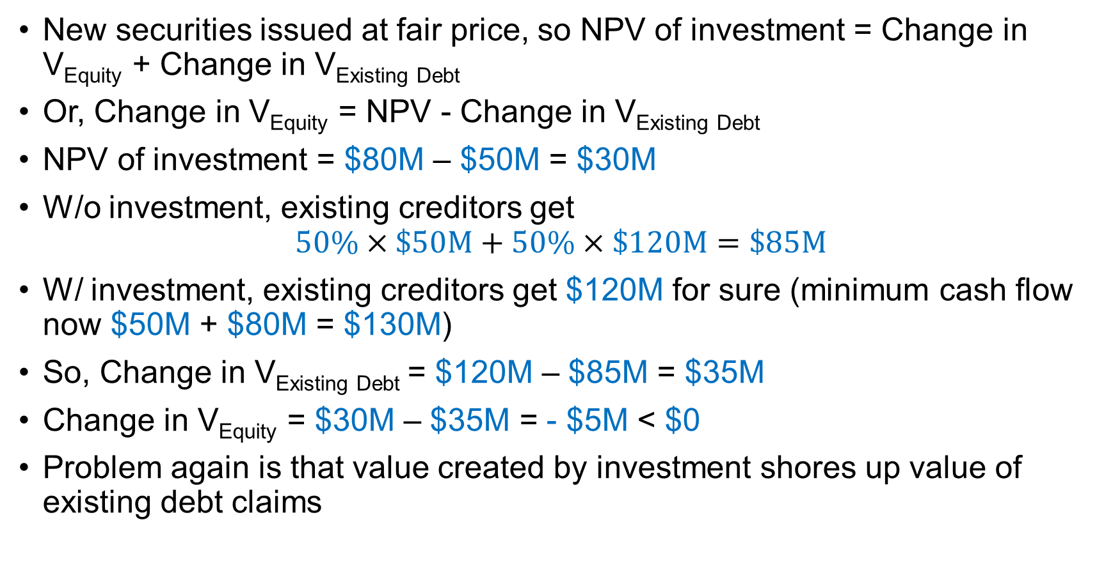
Debt overhang example 2
New securities issued at fair price, so NPV of investment = Change in V_{Equity} + Change in V_{Existing Debt}
Or, Change in V_{Equity} = NPV - Change in V_{Existing Debt}
NPV of investment = $80M – $50M = $30M
W/o investment, existing creditors get
$$50\%×\$50M+50\%×\$120M=\$85M$$
W/ investment, existing creditors get $120M for sure (minimum cash flow now $50M + $80M = $130M)
So, Change in V_{Existing Debt} = $120M – $85M = $35M
Change in V_{Equity} = $30M – $35M = - $5M < $0
Problem again is that value created by investment shores up value of existing debt claims

Slide 25
Debt overhang - takeaways
Company with a lot of debt may turn down positive NPV project if most of the value from investment accrues to existing creditors
Investing to shore up Chrysler’s finances during financial crisis might be bad for Cerberus, even if sustaining Chrysler is positive NPV investment
Debt overhang is a cost of financial distress (company would not turn down positive NPV project absent debt financing)
Debt overhang can be extremely costly for company pursuing growth strategy (may have to abandon strategy)
Perhaps not surprising that young, fast-growing companies (e.g., tech companies) tend to avoid debt financing

Slide 26
Risk shifting: New Century, 2004-07
New Century Financial Corporation
Second largest U.S. subprime mortgage originator in mid-2000s
Kept about 20% of mortgages on its balance sheet, many fixed rate
90% leverage, mostly floating-rate debt
Fed raised interest rates from 1.5% in 2004 to 5.25% in 2006
Squeezed New Century’s profits, reduced its equity value
Might expect New Century to reduce risk in response to squeeze
New Century’s response: Increase origination of high-risk interest-only mortgages, especially in areas where it already held mortgages
Why did New Century amp up risk in response to negative shock to its value?

Slide 27
Risk shifting example
Company has access to two mutually exclusive $75M investments, w/ cash flows:
50%
$100M
50%
$124M
Investment S
Investment R
50%
$60M
50%
$20M
Retailer:
S: Update product line
R: Shift to new product line
Manufacturer:
S: Upgrade existing equipment
R: New production technology
Bank:
S: Low-risk loans
R: Subprime mortgages

Slide 28
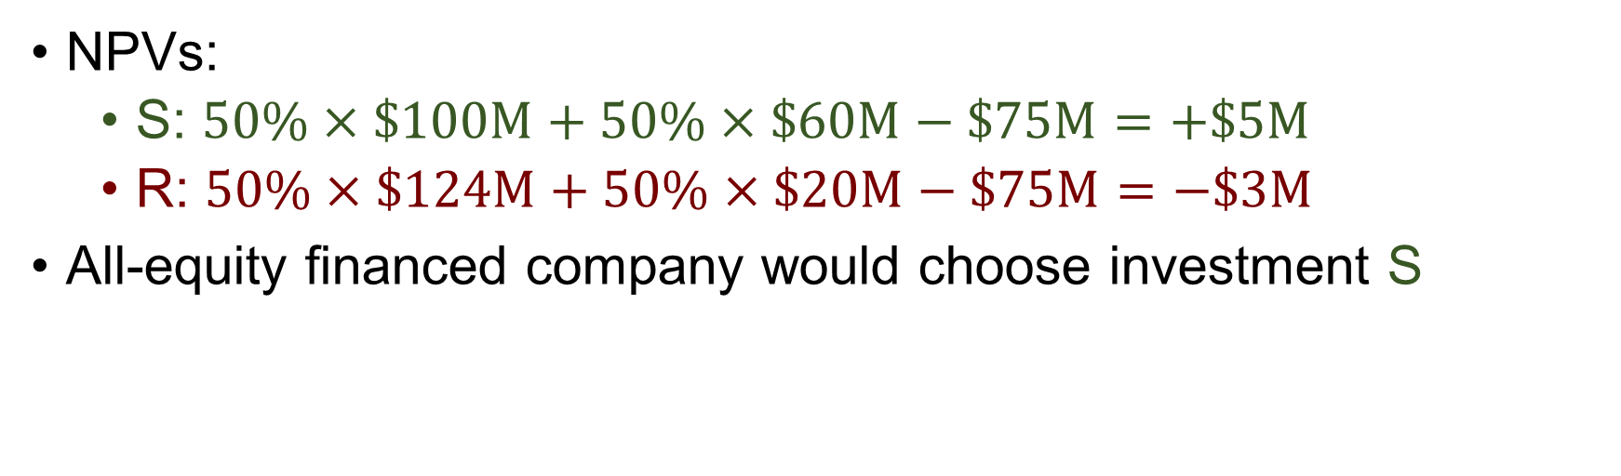
Risk shifting example
Company has access to two mutually exclusive $75M investments, w/ cash flows:
50%
$100M
50%
$124M
Investment S
Investment R
50%
$60M
50%
$20M
NPVs:
S: $50\%×\$100M+50\%×\$60M−\$75M=+\$5M$
R: $50\%×\$124M+50\%×\$20M−\$75M=−\$3M$
All-equity financed company would choose investment S

Slide 29
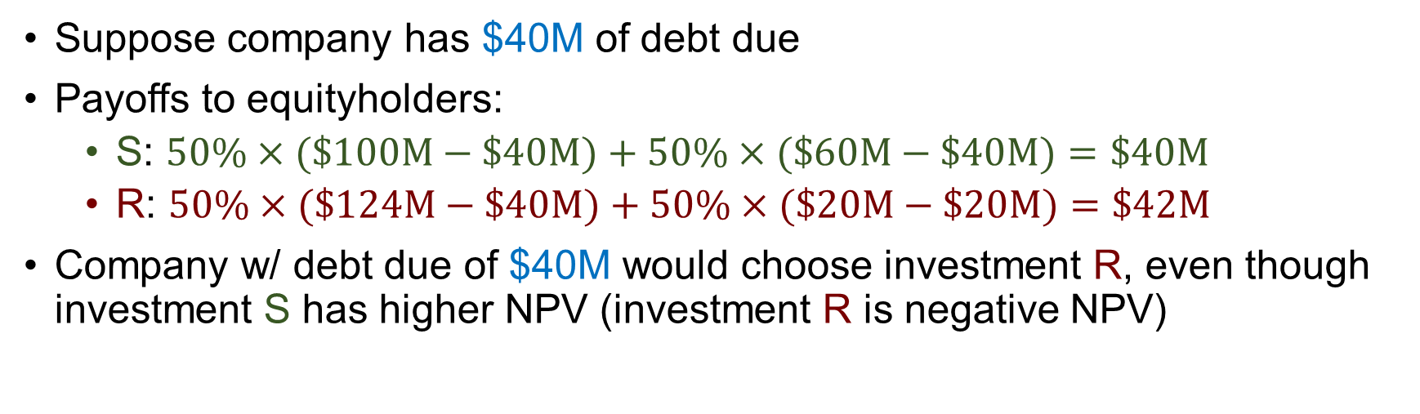
Risk shifting example
Company has access to two mutually exclusive $75M investments, w/ cash flows:
50%
$100M
50%
$124M
Investment S
Investment R
50%
$60M
50%
$20M
Suppose company has $40M of debt due
Payoffs to equityholders:
S: $50\%×(\$100M−\$40M)+50\%×(\$60M−\$40M)=\$40M$
R: $50\%×(\$124M−\$40M)+50\%×(\$20M−\$20M)=\$42M$
Company w/ debt due of $40M would choose investment R, even though investment S has higher NPV (investment R is negative NPV)

Slide 30
Equityholders, creditors, & risk
Equity value
Debt value
Debt
Asset value
Riskier assets
Equity holders benefit from upside, creditors bear most downside risk → equity holders in companies w/ debt have incentives to take risk

Slide 31
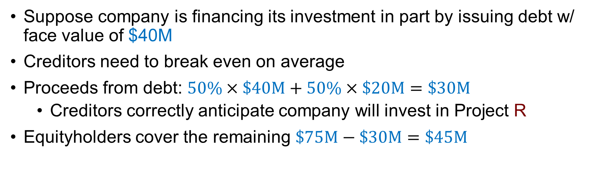
Risk shifting example
Company has access to two mutually exclusive $75M investments, w/ cash flows:
50%
$100M
50%
$124M
Investment S
Investment R
50%
$60M
50%
$20M
Suppose company is financing its investment in part by issuing debt w/ face value of $40M
Creditors need to break even on average
Proceeds from debt: $50\%×\$40M+50\%×\$20M=\$30M$
Creditors correctly anticipate company will invest in Project R
Equityholders cover the remaining $\$75M−\$30M=\$45M$

Slide 32
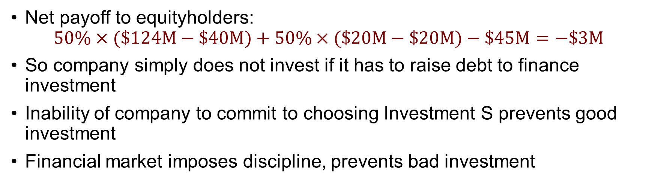
Risk shifting example
Company has access to two mutually exclusive $75M investments, w/ cash flows:
50%
$100M
50%
$124M
Investment S
Investment R
50%
$60M
50%
$20M
Net payoff to equityholders:
$$50\%×(\$124M−\$40M)+50\%×(\$20M−\$20M)−\$45M=−\$3M$$
So company simply does not invest if it has to raise debt to finance investment
Inability of company to commit to choosing Investment S prevents good investment
Financial market imposes discipline, prevents bad investment

Slide 33
Risk-shifting & debt guarantees
What if the government guarantees the company’s debt?
Bank deposit insurance = explicit guarantee
U.S. government guarantees first $250,000 of bank deposits
Bank deposit guarantees intended to prevent bank runs
Too-big-to-fail/too-systemic-to-fail = implicit guarantee
Difficult for government to commit not to bail out systemically important company(ies) even if it wants to

Slide 34
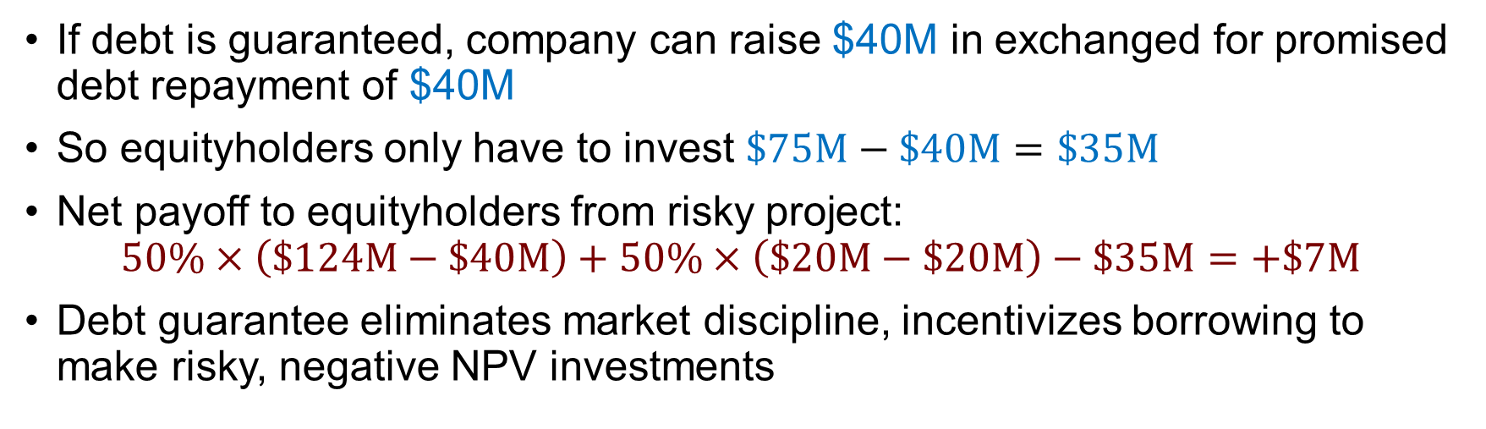
Risk shifting example continued
Company has access to two mutually exclusive $75M investments, w/ cash flows:
50%
$100M
50%
$124M
Investment S
Investment R
50%
$60M
50%
$20M
If debt is guaranteed, company can raise $40M in exchanged for promised debt repayment of $40M
So equityholders only have to invest $\$75M−\$40M=\$35M$
Net payoff to equityholders from risky project:
$$50\%×\left(\$124M−\$40M\right)+50\%×\left(\$20M−\$20M\right)−\$35M=+\$7M$$
Debt guarantee eliminates market discipline, incentivizes borrowing to make risky, negative NPV investments

Slide 35
Risk-shifting & the financial crisis
Risk-shifting as narrative for financial crisis of 2008
Consolidation in banking → growth of “too big too fail” banks
Government relaxed capital requirements for investment banks
Rising interest rates + asset/liability mismatch (fixed rate mortgages & floating rate funding) → reduced “charter” (i.e., equity) value
Many financial institutions loaded up on housing risk → systemic risk → harder for government to commit to no bailout policy if housing market tanks → stronger incentives to load up on housing risk

Slide 36
Debt & other stakeholders
Alphabet’s financials for FYE 2018:
Total assets: $232.8B (includes cash & short-term investments of $109.1B)
Total debt: $4.0B
Net income: $30.7B
Alphabet can borrow at close to the risk-free rate; why so little debt?
Tech companies = collections of talent, can be fragile
Financial distress can be a self-fulfilling prophecy
High risk of future financial distress (budget cuts, downsizing) → talent leaves
Talent leaves → low productivity → high risk of future financial distress
High-human capital firms may avoid debt to minimize risk

Slide 37
Financial distress & incentives
Financial distress is costly when it happens
But debt (and worries about financial distress) can benefit shareholders by imposing discipline on management
Fear of bankruptcy as a motivator
Failure to repay debt triggers bankruptcy
More than 50% of CEOs (of publicly-traded companies) lose their jobs after a bankruptcy
Debt limits free cash flow
Management may invest free cash flow wastefully (pet projects, empire building, perquisites such as corporate jets)
Interest payments consume free cash flow management might otherwise waste

